Slide 1
Machine Learning
Bagging and Boosting

Slide 2
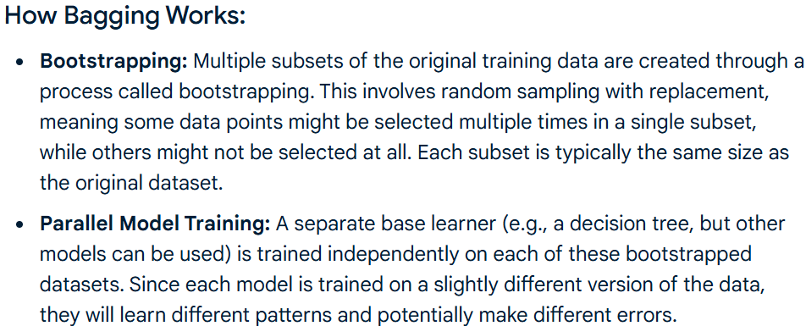
Bagging
Bagging, or Bootstrap Aggregating, is an ensemble learning method in machine learning designed to improve the stability and accuracy of models, primarily by reducing variance and preventing overfitting.

Slide 3
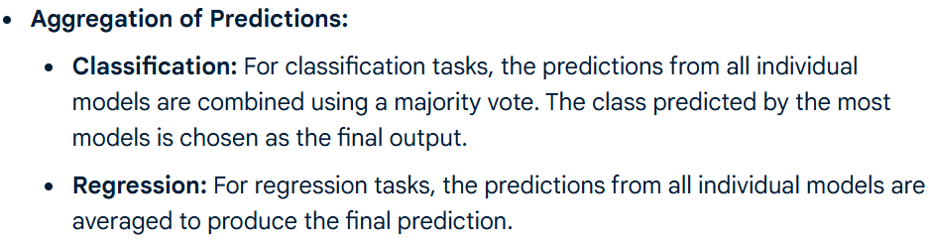
Bagging

Slide 4
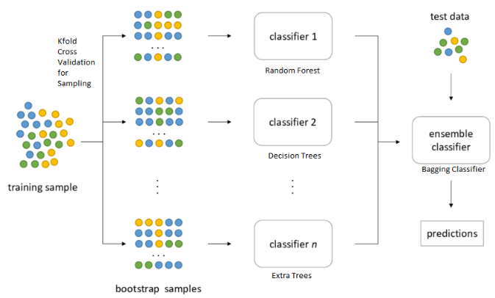
Bagging
medium.com

Slide 5
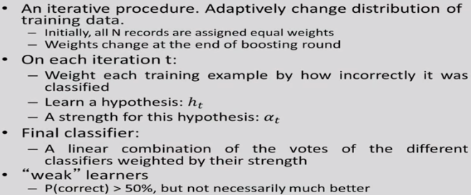
Boosting
Dr. Sudeshna Sarkar, IIT Kharagpur

Slide 6
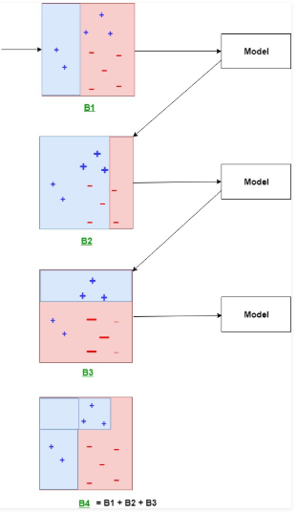
Boosting
geeksforgeeks.org

Slide 7
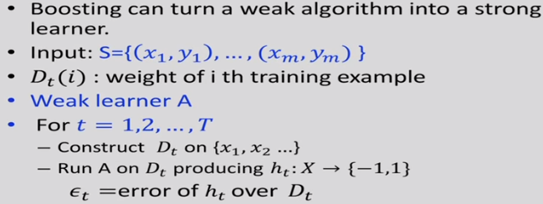
Adaboost
Dr. Sudeshna Sarkar, IIT Kharagpur

Slide 8
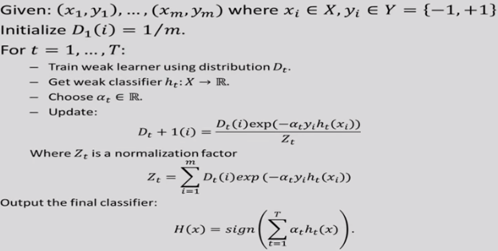
Adaboost
Dr. Sudeshna Sarkar, IIT Kharagpur

Slide 9
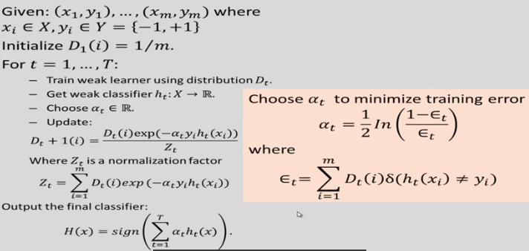
Adaboost
Dr. Sudeshna Sarkar, IIT Kharagpur

Slide 10
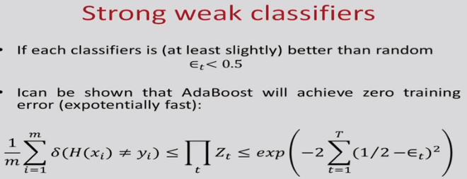
Dr. Sudeshna Sarkar, IIT Kharagpur

Slide 11
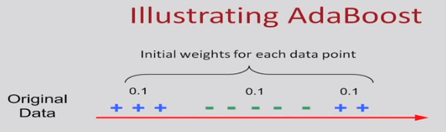
Dr. Sudeshna Sarkar, IIT Kharagpur

Slide 12
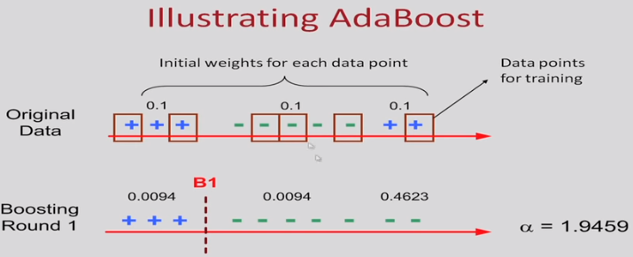
Dr. Sudeshna Sarkar, IIT Kharagpur

Slide 13
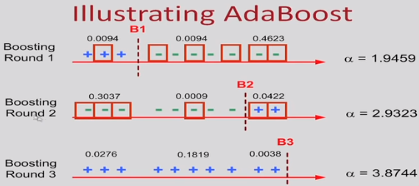
Dr. Sudeshna Sarkar, IIT Kharagpur

